Slide 1
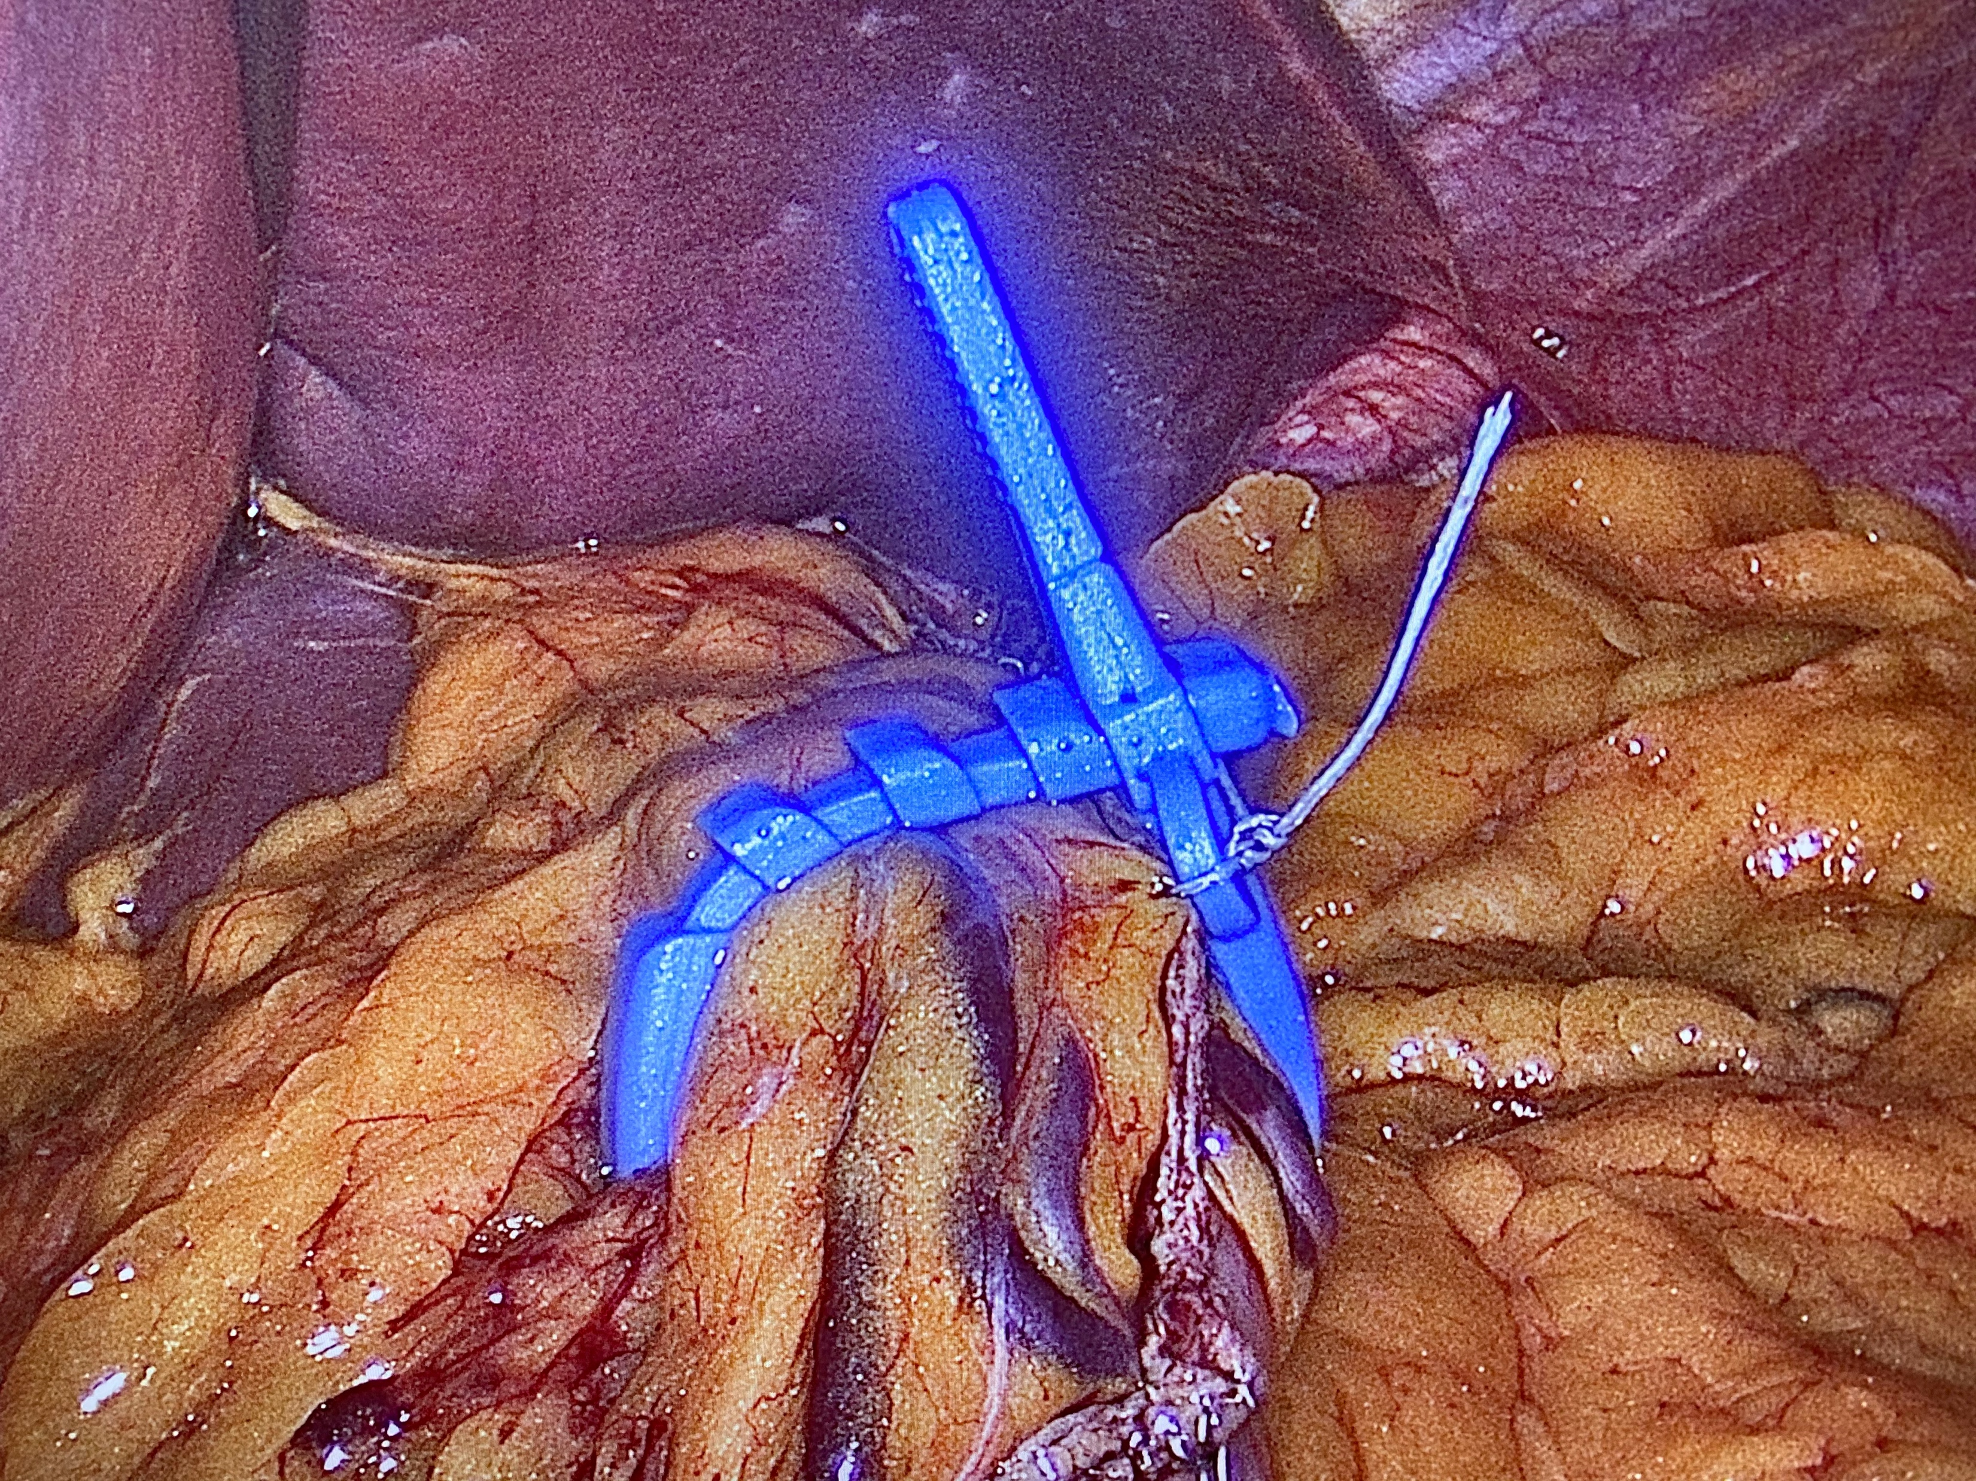
Banded Sleeve
Paolo Gentileschi, University of Rome Tor Vergata
Bariatric and Metabolic Surgery Unit, Chief
Maria Cecilia Hospital – Cotignola (RA)
San Carlo of Nancy Hospital – Rome – Italy

Slide 2
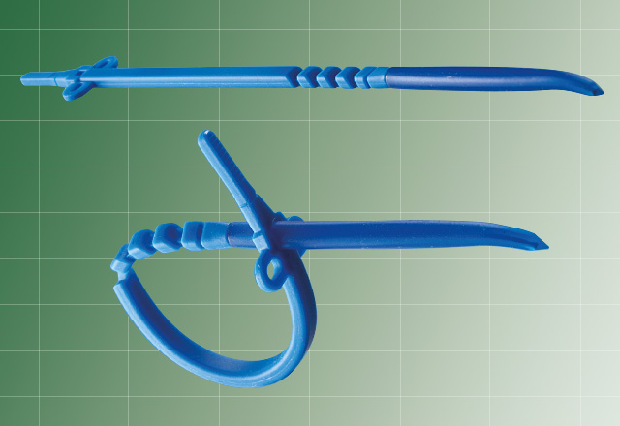
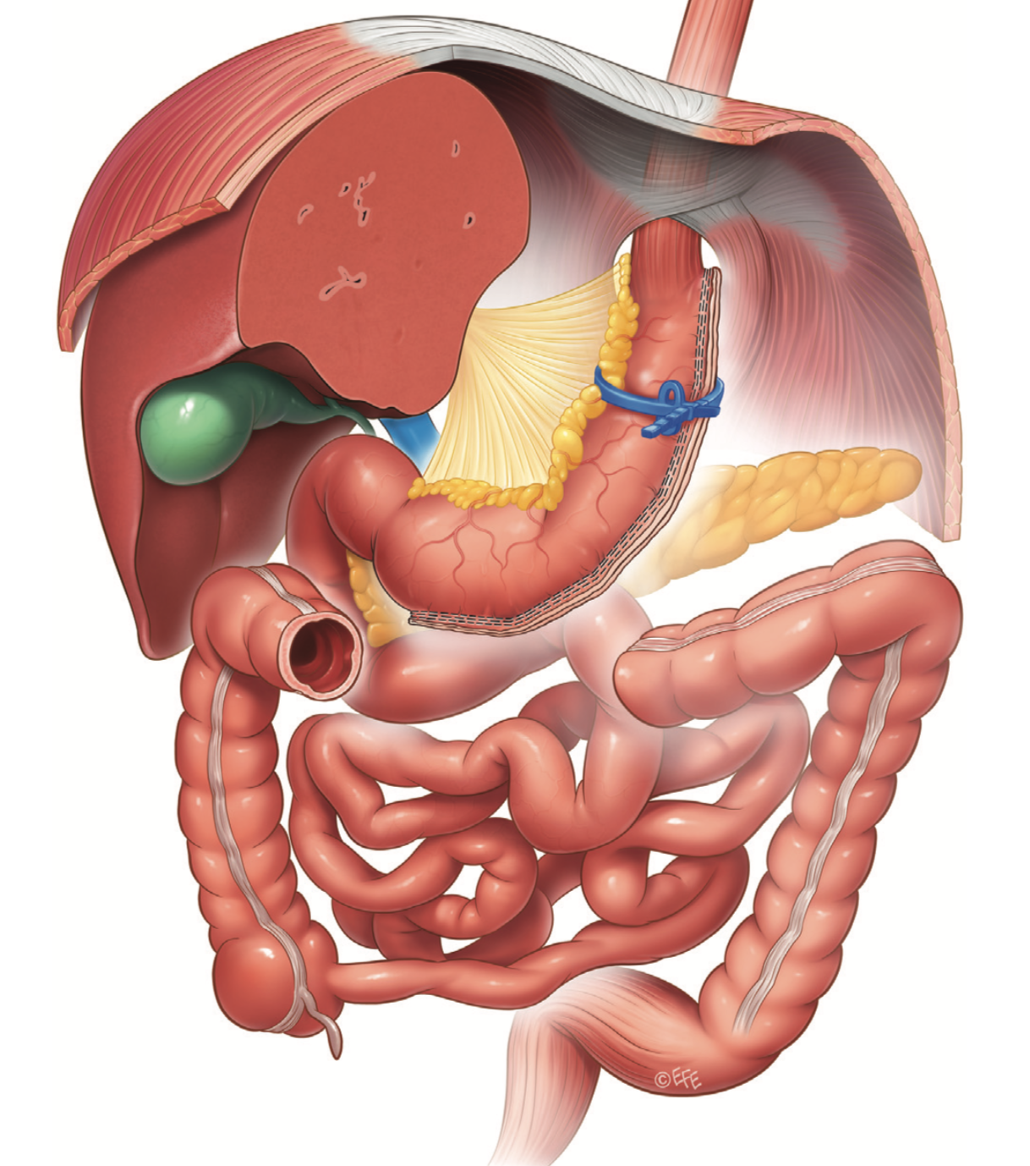
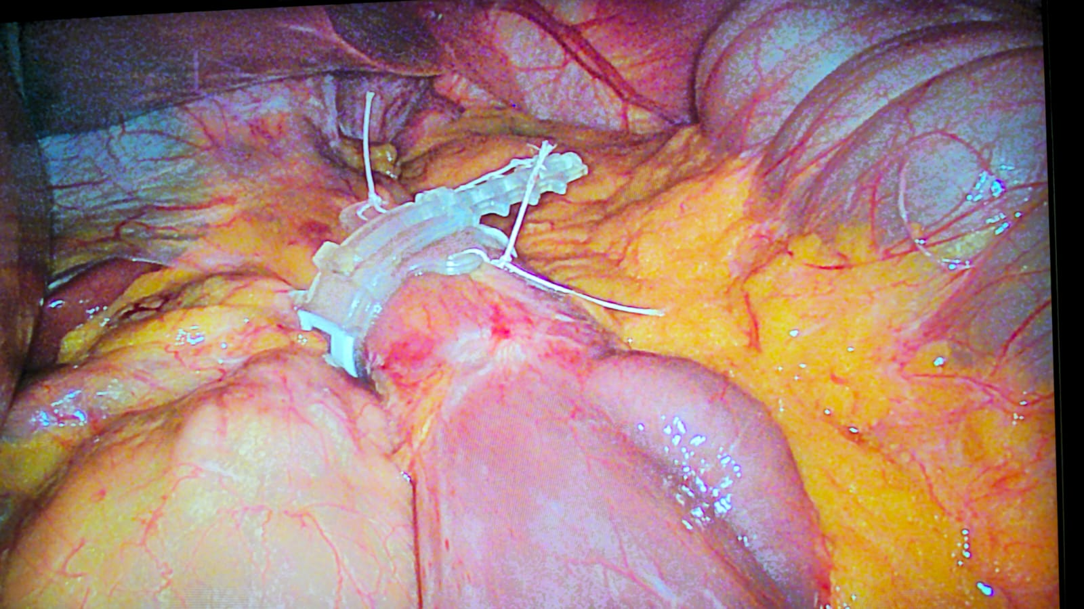
Banded procedures with the Ring
Personal Series
527 BANDED SLEEVES
66 BANDED RYGBs
49 BANDED REDOs
116 BANDED OAGBs

Slide 3
Revisional Bariatric Surgery for Failure or Weight regain
 | Mean %EWL | Mean % Weight Regain Pts (> 50% EWL) at 5 years
 | 55-70% | 8-20%
Pouch and/or outlet dilatation
Pouch revision and conversion to Banded RYGBP (??)

Slide 4
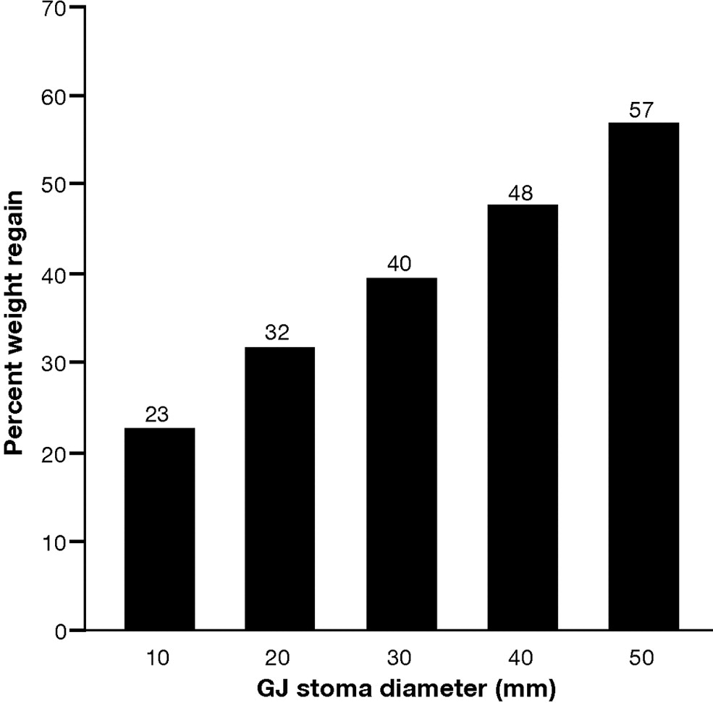
Weight regain and stoma diameter
Predicted percentage of
maximal weight lost after
RYGB that was regained
in 5 years after the procedure
at different GJ stoma diameters
based on the linear regression
model.
Source: Clinical Gastroenterology and Hepatology 2011; 9:228-233 (DOI:10.1016/j.cgh.2010.11.004 )
Copyright © 2011 AGA Institute Terms and Conditions
Notes:
Predicted percentage of maximal weight lost after RYGB that was regained in 5 years after the procedure at different GJ stoma diameters based on the linear regression model.

Slide 6
Banded sleeve: rationale
Incidence of weight regain was 17.6% (n = 2314/13,152; 95% CI 16.9–18.3).
Sleeve, 16-29%

Slide 7
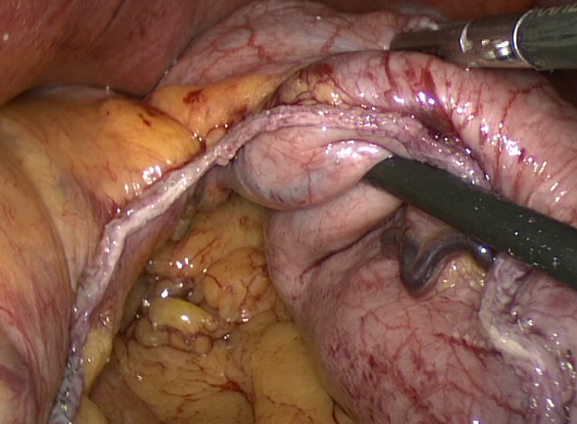
Banding the Sleeve
Technical Aspects

Slide 8
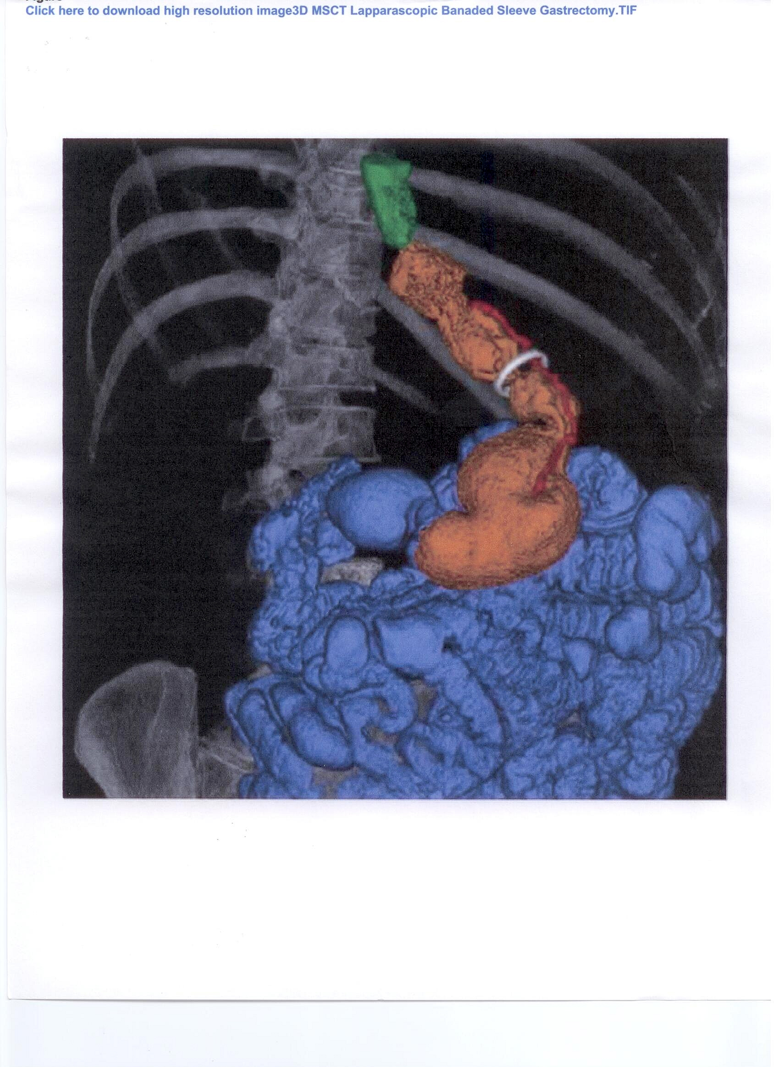
High resolution image 3d of a Banded Sleeve Gastrectomy

Slide 9
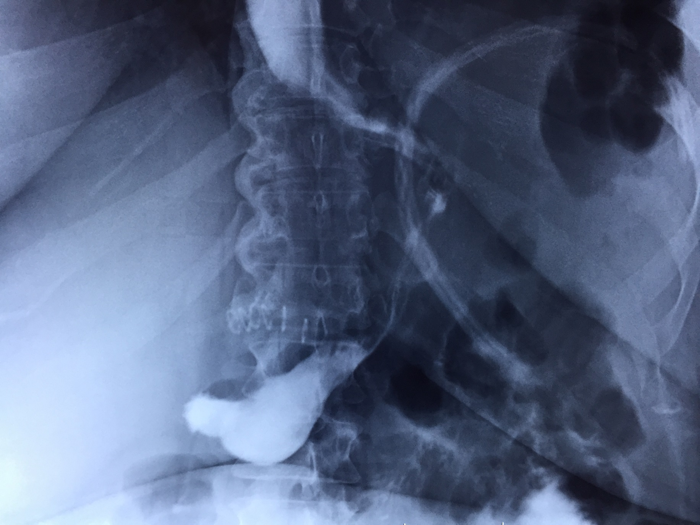

Slide 10
Technical Aspects
RETROGASTRIC TUNNEL
PARS FLACCIDA TECHNIQUE
PERIGASTRIC TECHNIQUE
ONE SIZE FITS ALL
MEDIALLY TO LATERAL STARTING 4 CM FROM THE EG JUNCTION

Slide 11
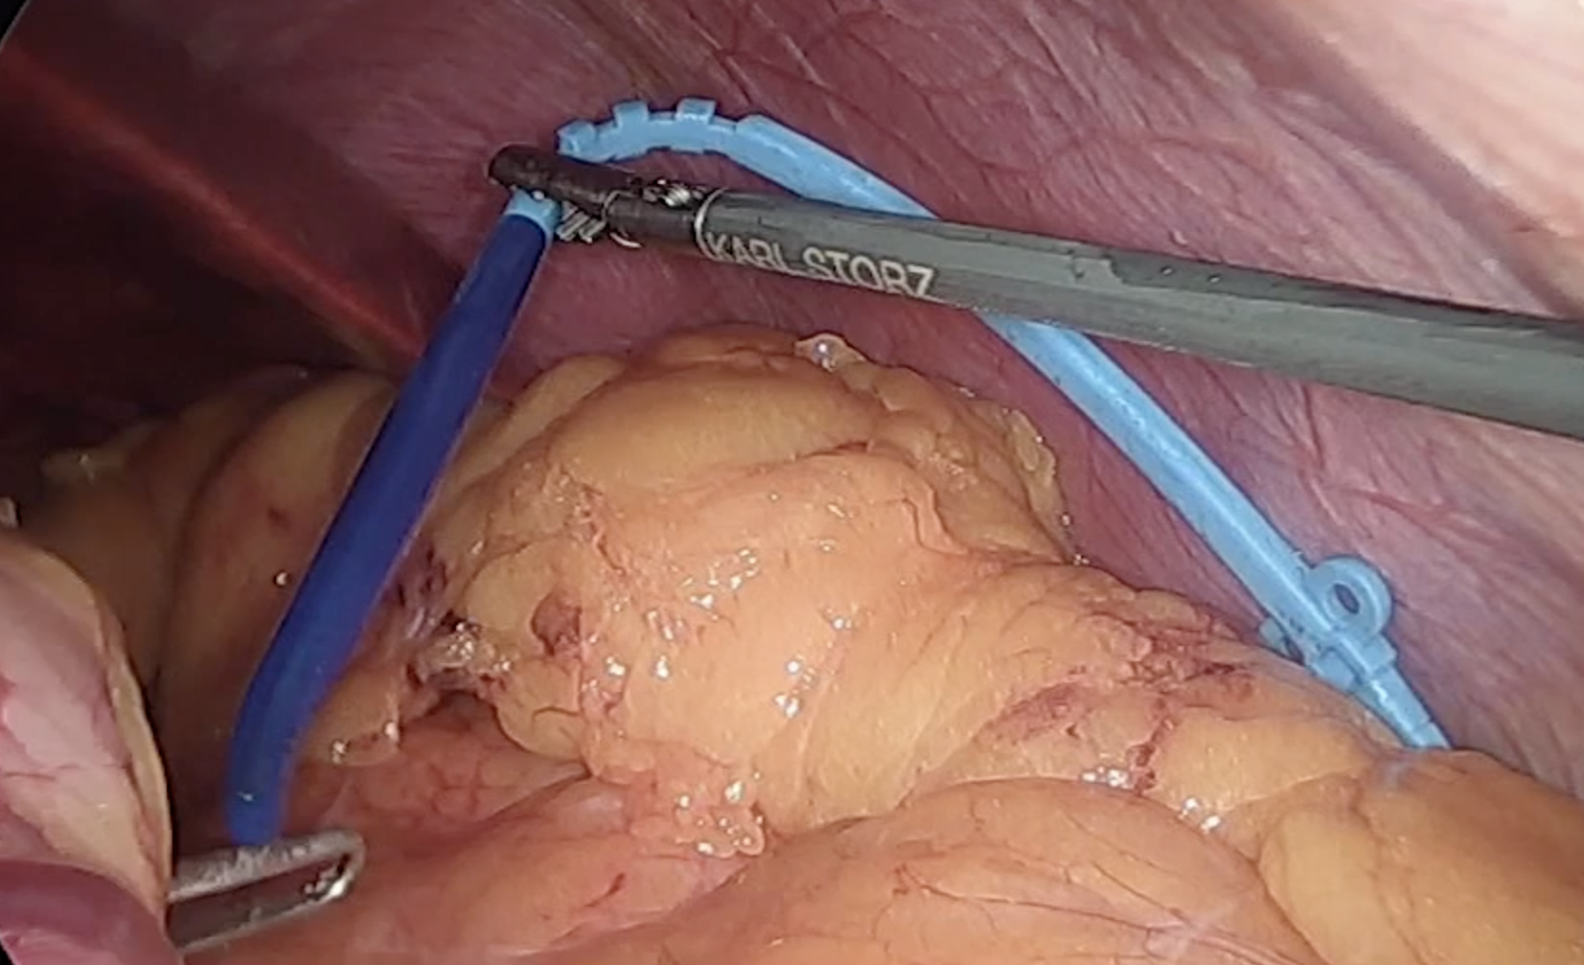
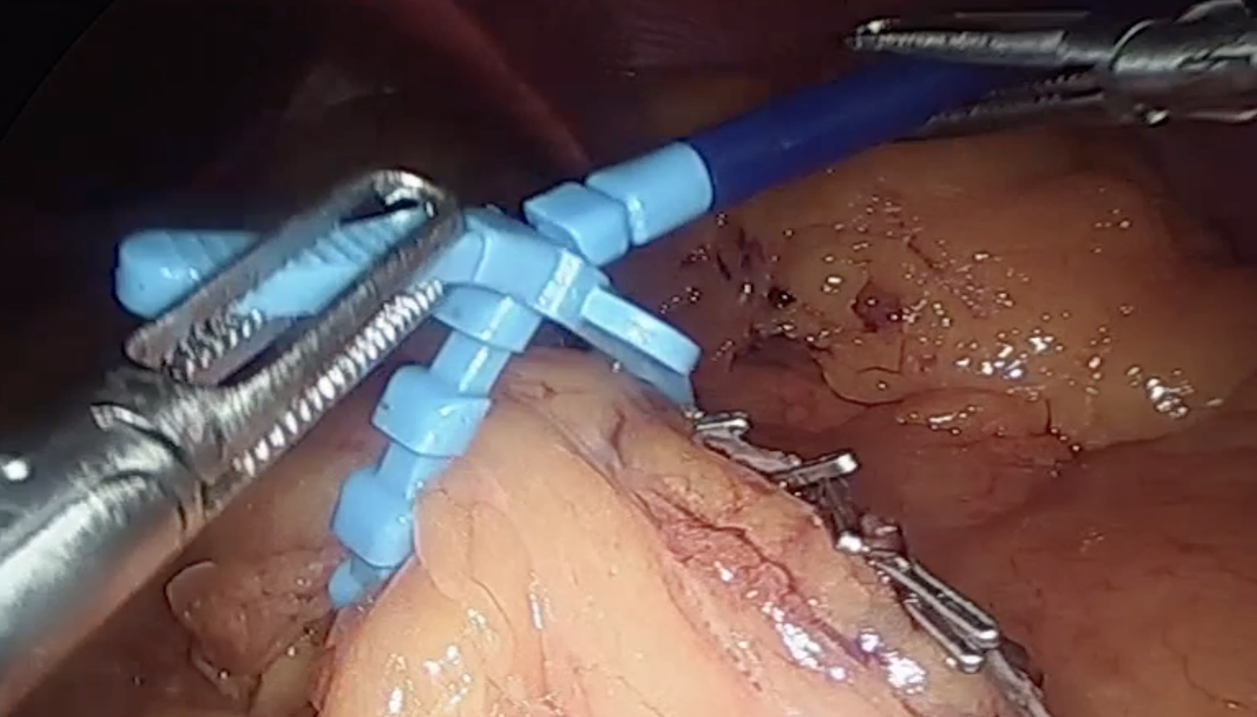
GRAB THE RING FROM THE HARD BLUE SIDE ANDD PULL IT OVER THE SLEEVE
CLOSE THE RING OVER THE BOUGIE (36 FR) AT THE FIRS STEP

Slide 12
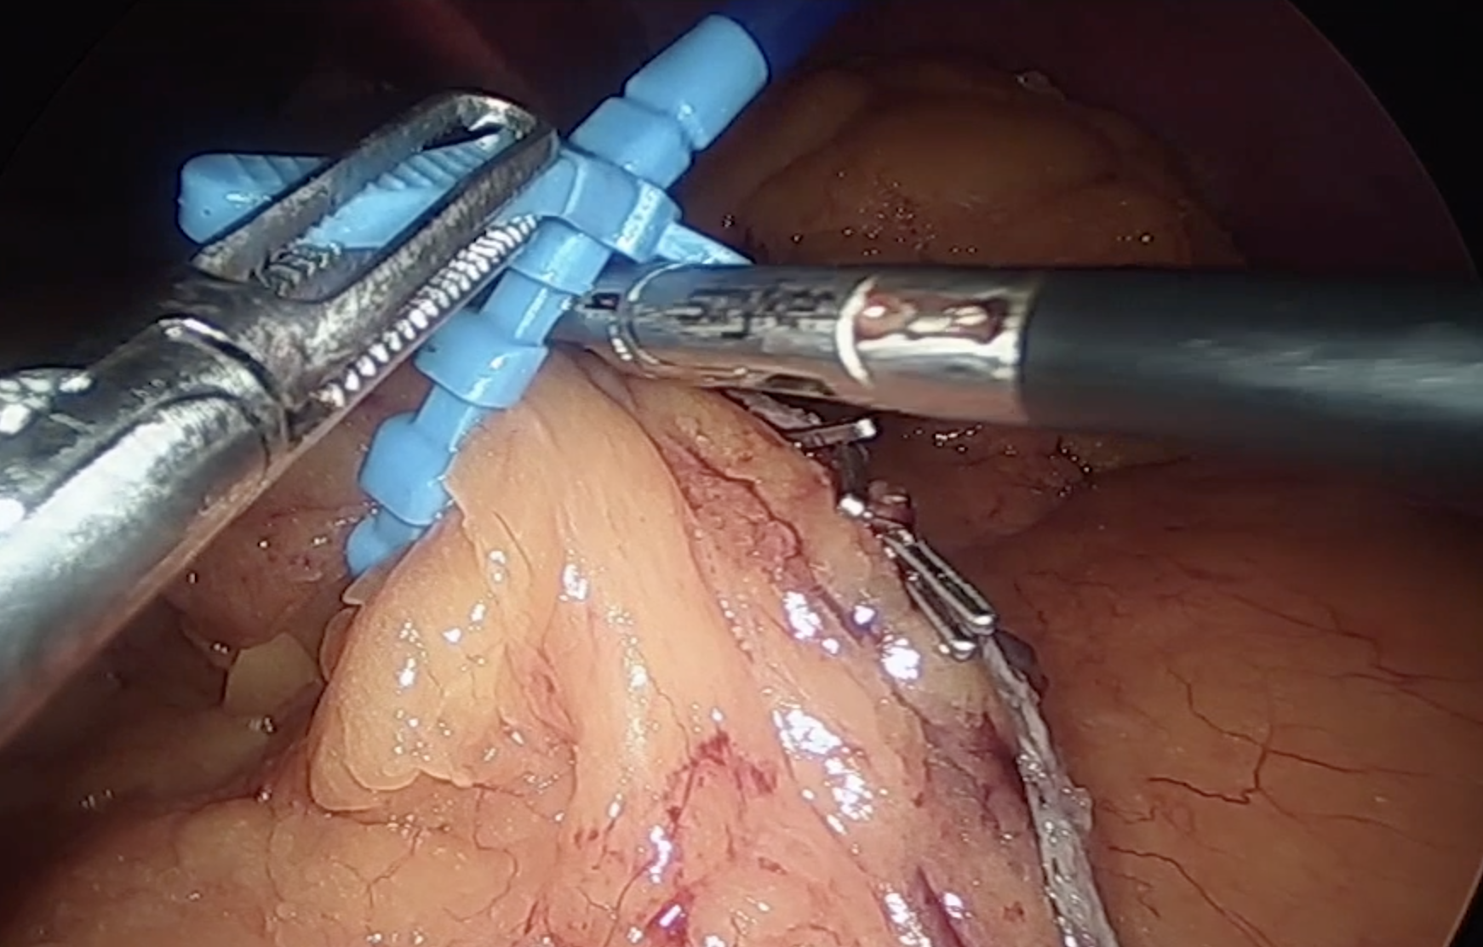
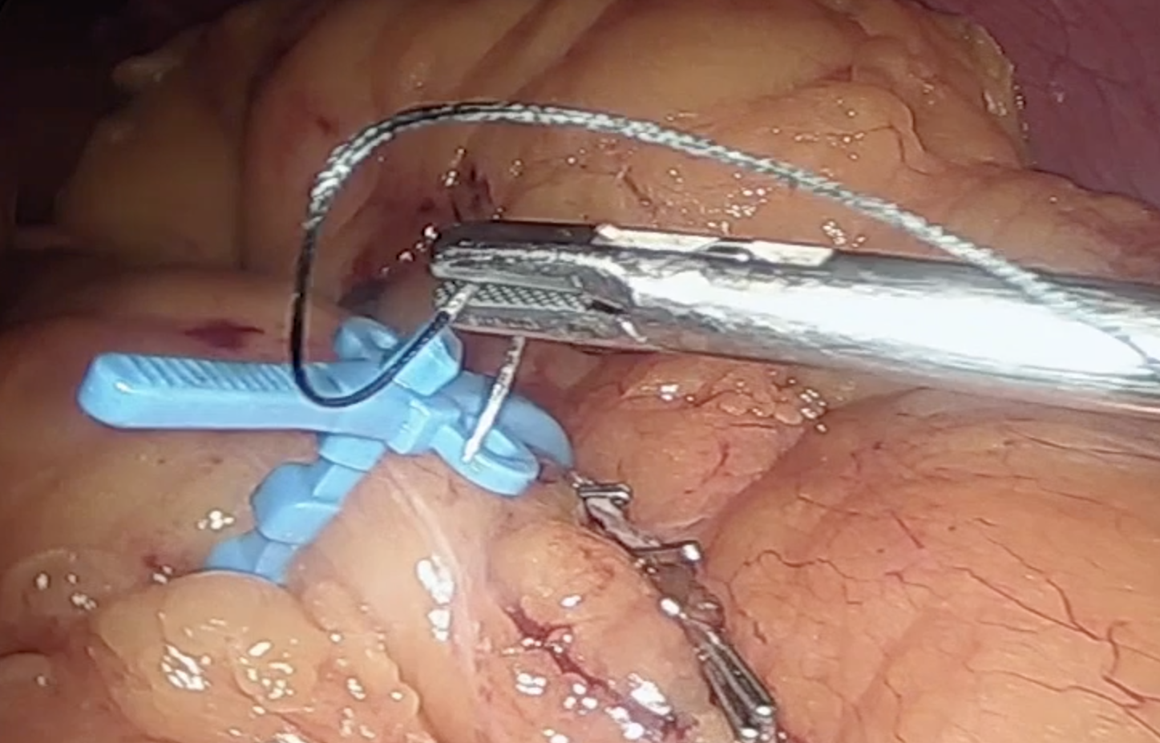
THE RING HAS TO BE LEFT IN PLACE IN A LOOSE FASHION (WE DON’T WANT TO CREATE A STRICTURE WICH COULD INCREASE THE PRESSURE AND THE GASTRIC LEAK INCIDENCE)
REMOVE THE BOUGIE AFTER METHYLENE BLUE TEST AND SECURE THE RING WITH TWO NON-ABSORBABLE SUTURES

Slide 13
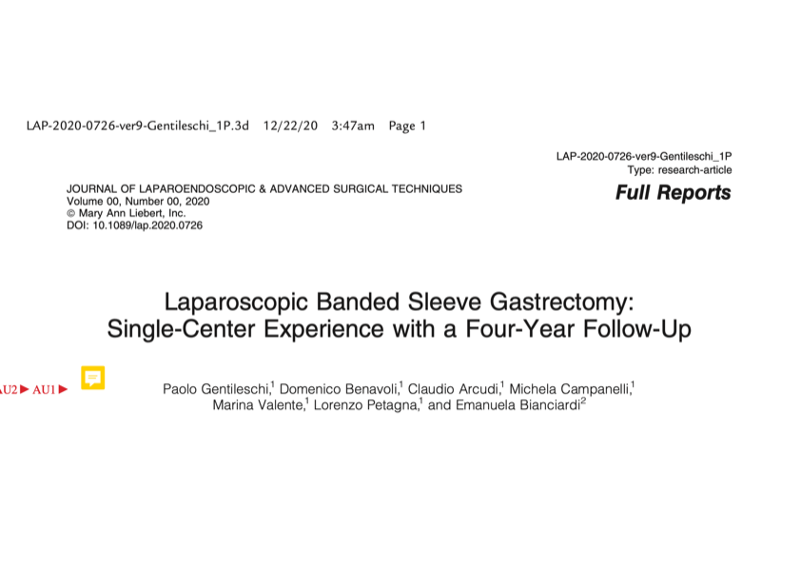

Slide 14
Banded sleeve: results

Slide 15
Banded sleeve: results
Failure to achieve BMI < 35 kg/m2 was more frequent in the group who underwent SG (67.9%), followed by RYGB (29.16%), BRYGB (22.2%), OAGB (9.87%), and none in the BSG group.

Slide 16
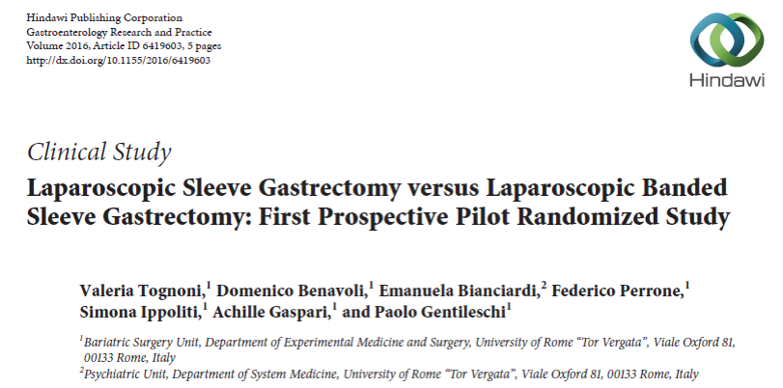
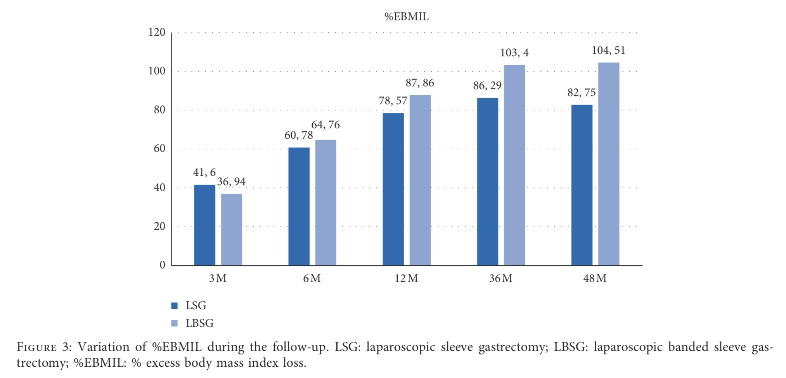
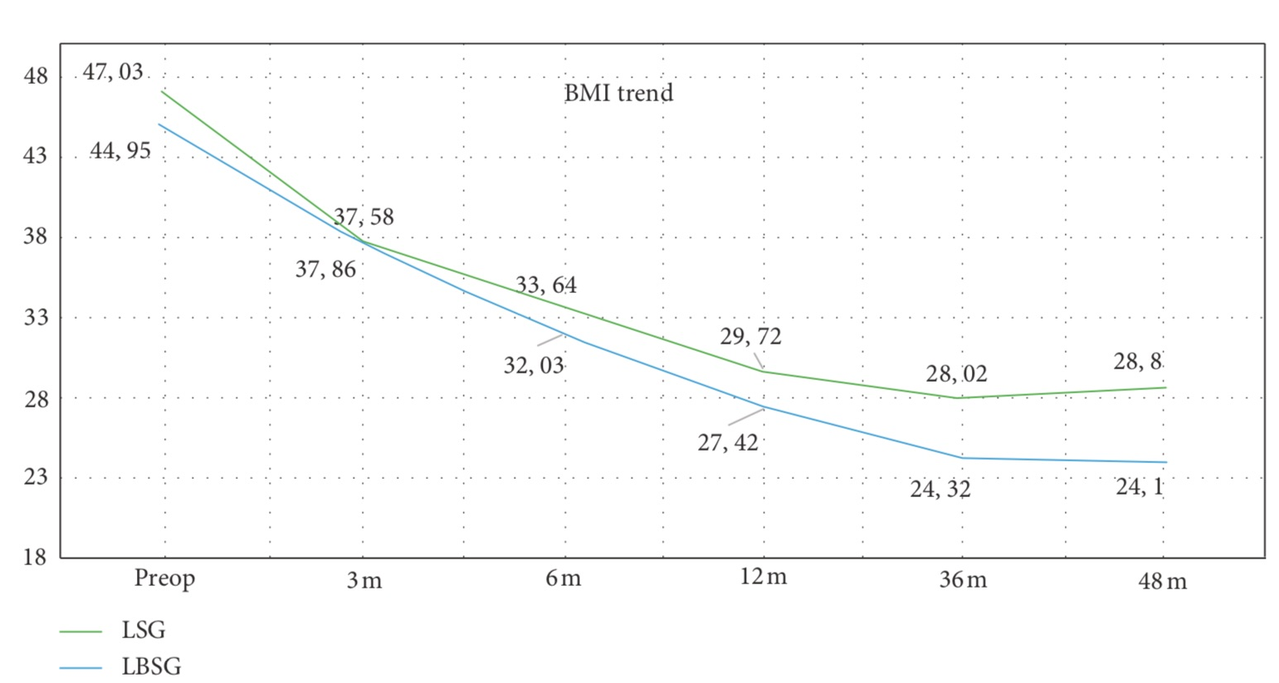
Banded sleeve: results

Slide 17
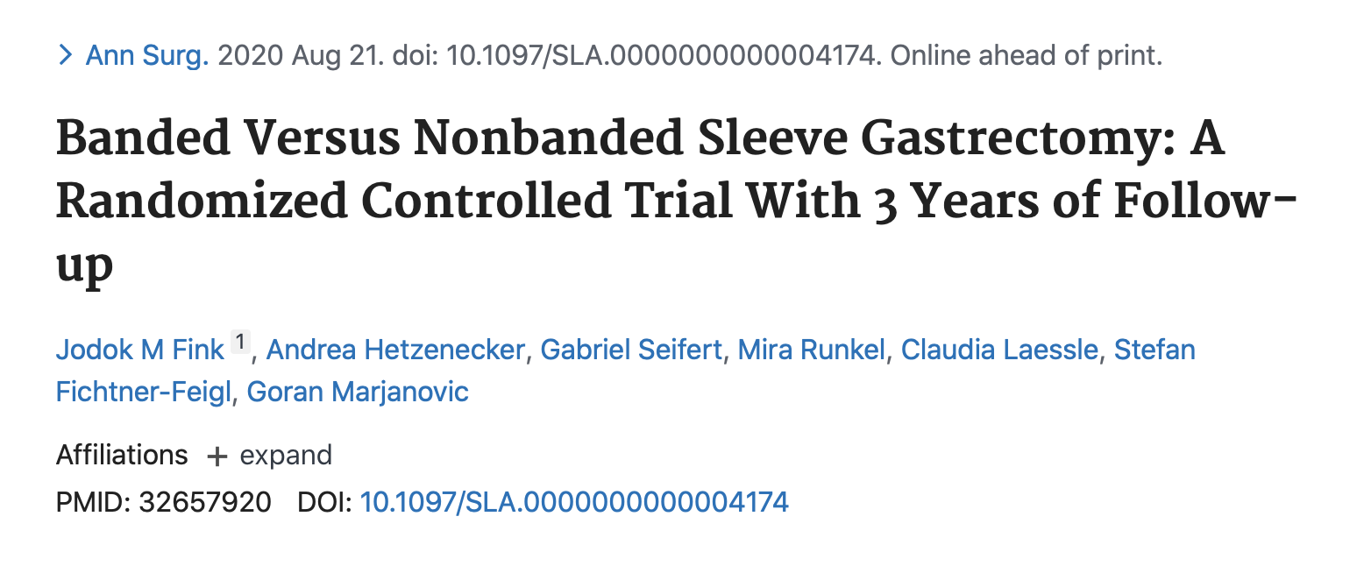

Slide 18
Banded sleeve: results
Adjusted %EWL 3 years after surgery was 62.3% (95% CI, 56.2–68.5) for SG and 73.9% (95% CI, 67.8–80.0) for BSG (P = 0.0073).
At 3 years, adjusted BAROS score was 1.5 points higher in BSG (BSG 6.44; SG 4.98; P = 0.0017).

Slide 19
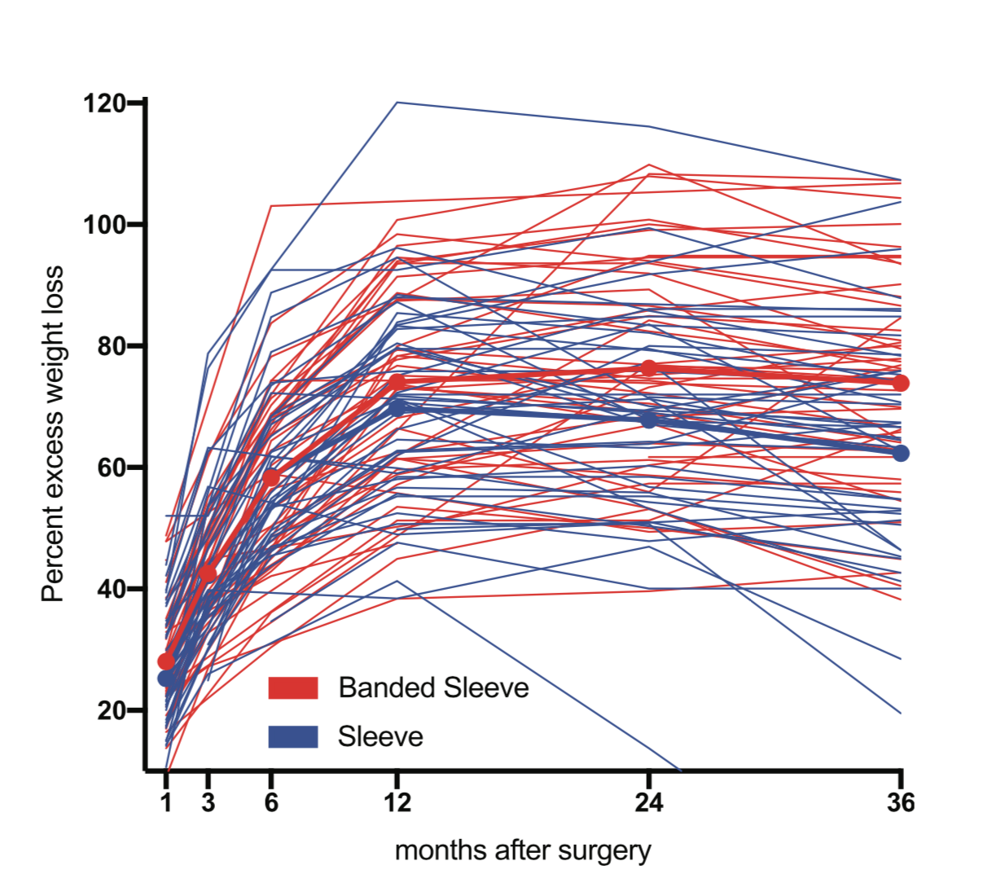

Slide 20
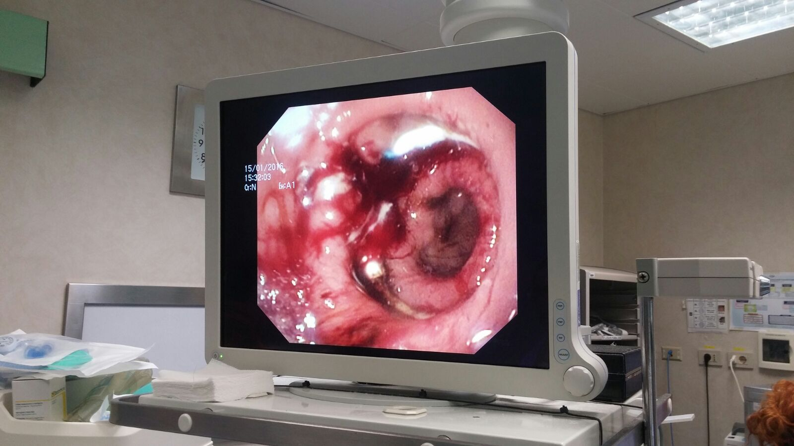

Slide 21
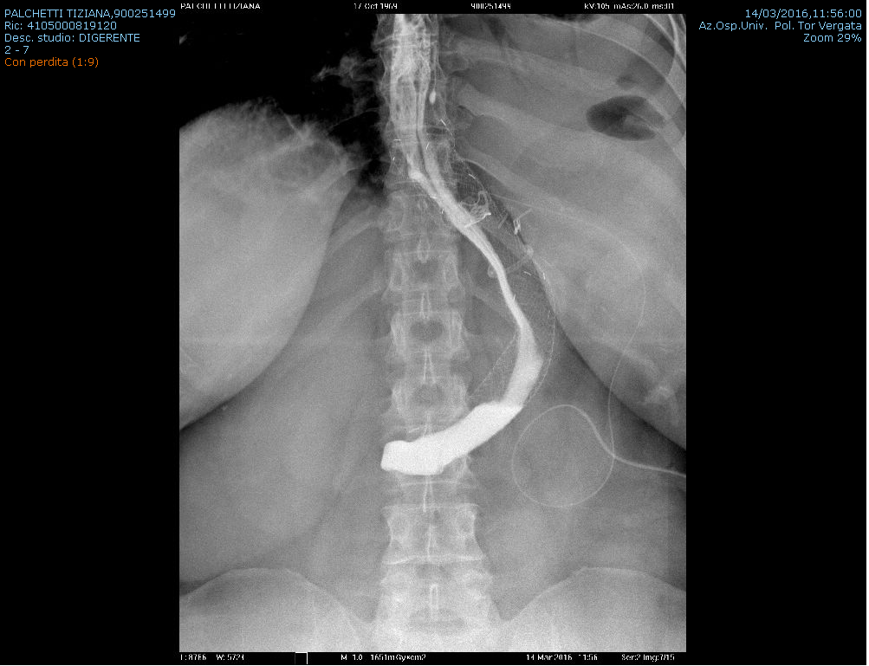

Slide 22
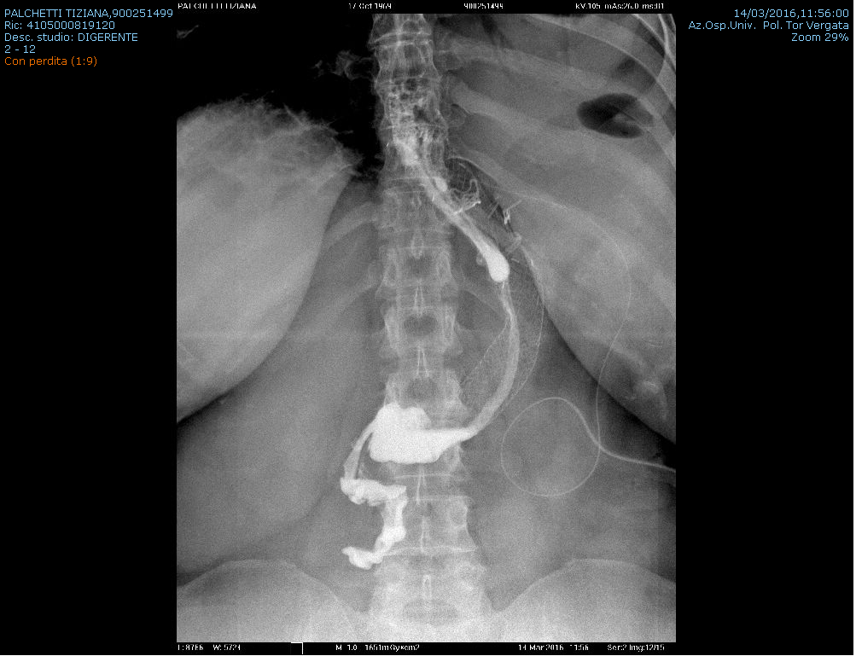

Slide 23
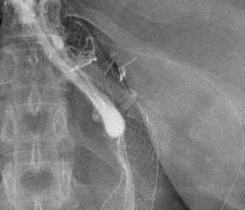

Slide 24
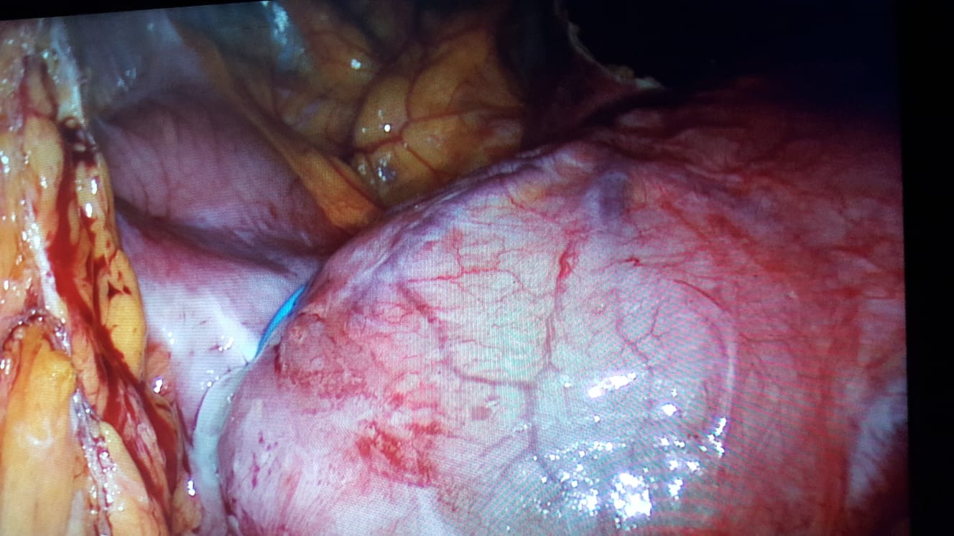

Slide 25
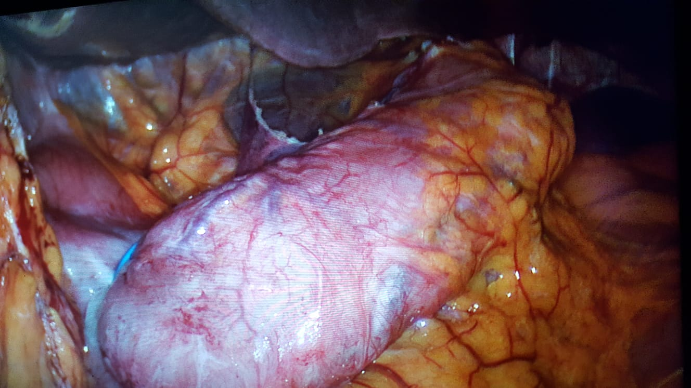

Slide 26
Banded Sleeve CONCLUSIONS
ALWAYS!!!
WHY NOT?

